Slide 1
Your Resume
Marketing Yourself to a Higher Standard

Slide 2
“Copyright and Terms of Service
Copyright © Texas Education Agency. The materials found on this website are copyrighted © and trademarked ™ as the property of the Texas Education Agency and may not be reproduced without the express written permission of the Texas Education Agency, except under the following conditions:
Texas public school districts, charter schools, and Education Service Centers may reproduce and use copies of the Materials and Related Materials for the districts’ and schools’ educational use without obtaining permission from the Texas Education Agency;
2) Residents of the state of Texas may reproduce and use copies of the Materials and Related Materials for individual personal use only without obtaining written permission of the Texas Education Agency;
3) Any portion reproduced must be reproduced in its entirety and remain unedited, unaltered and unchanged in any way;
4) No monetary charge can be made for the reproduced materials or any document containing them; however, a reasonable charge to cover only the cost of reproduction and distribution may be charged.
Private entities or persons located in Texas that are not Texas public school districts or Texas charter schools or any entity, whether public or private, educational or non-educational, located outside the state of Texas MUST obtain written approval from the Texas Education Agency and will be required to enter into a license agreement that may involve the payment of a licensing fee or a royalty fee.

Slide 3
Resumes
A vital tool for today's job-seeker.
Is your marketing or selling tool that outlines your skills and experiences?
3

Slide 4
At a Glance
It usually take an employers 30 seconds or less to make a decision based on your resume.
That’s how long it takes for an employer to consider you.
4
Notes:
Explain to students the various sections that are listed on a resume, explain each section in detail.

Slide 5
Parts of a Resume
Objective
Tells a prospective employer the type of work you are currently pursuing.
Education
Should almost always immediately follow the objective statement. Your education is your most recent significant accomplishment and is usually related to your objective. (Format: 19xx-19xx Degree obtained, school name)
Work Experience
Allows you to include any experience in which you learned or demonstrated skills, knowledge or abilities that are related to the type of job you are seeking. If at all possible, use relevant experience to support your objective.
References
Some one who can verify your credentials and all or part of the information you have written in your resume
5
Notes:
Explain to students the various sections that are listed on a resume, explain each section in detail.

Slide 6
Other Categories
Skills
Special skills, certifications or licenses.
Activities and Interests
Languages
6
Notes:
Explain to students the various sections that are listed on a resume, explain each section in detail.

Slide 7
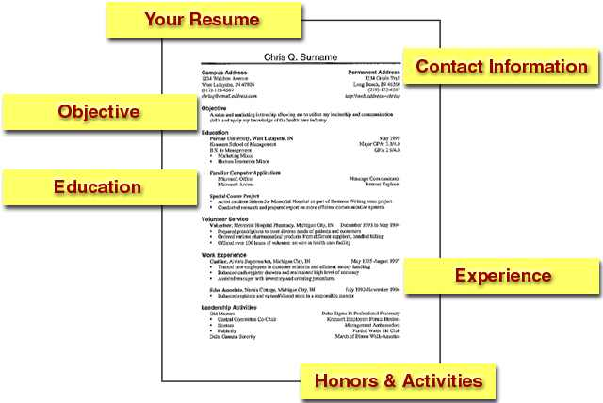
http://www.nassaulibrary.org/centreblog/resume.jpg
7

Slide 8
Resume Types
Chronological resumes
This type of resume is most common and organized by your employment history in reverse chronological order (working backwards from the last 10-15 years).
Functional resumes
Preferred by job-seekers with a limited job history or a job history in a different career field.
Combination resumes
Resume includes elements of both the chronological and functional formats.
8
Notes:
Chronological resume is structured around dates, employers, and titles, beginning with your most recent job and working backward to your first position in the workplace. This format enables you to demonstrate a steady progression of your work skills and responsibilities. On the other hand, this resume type also focuses the reader's attention on what you have done, rather than on what you can do.
Functional resume leads with your strength by focusing on your skills and abilities, regardless of when you applied them in your career. The details of your employment history are included only to the extent that they illustrate your functional expertise.

Slide 9
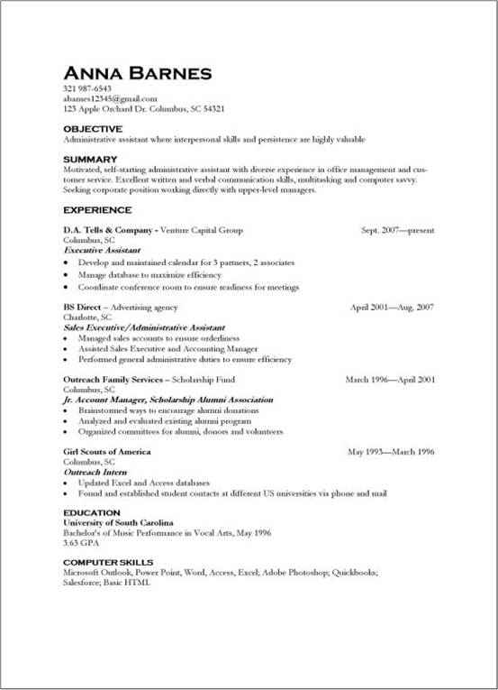
Chronological Resume
9

Slide 10
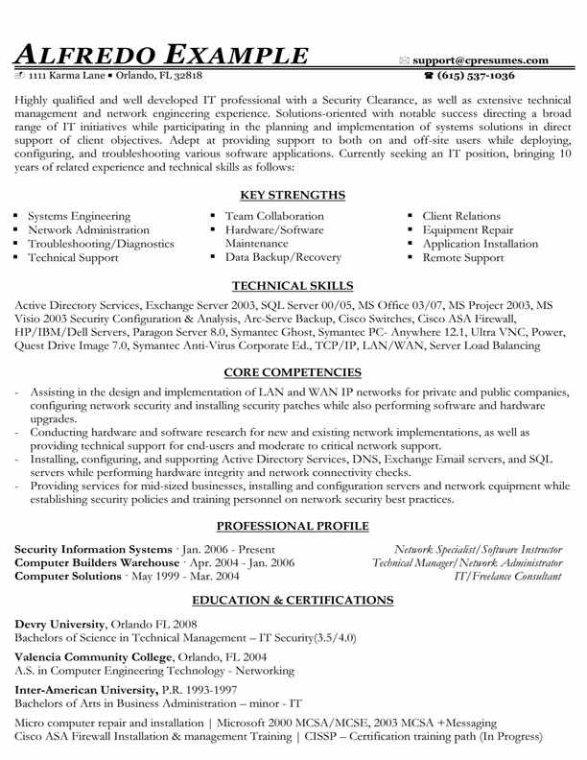
Functional Resume
10

Slide 11
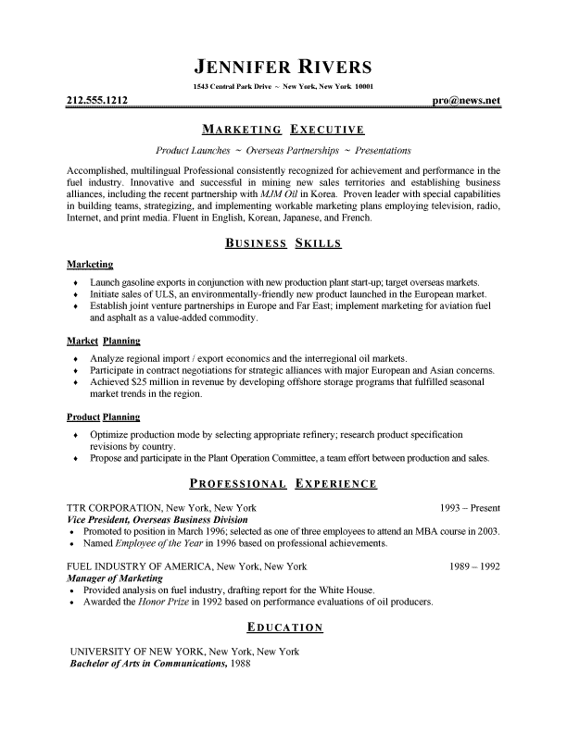
Combination Resume
11

Slide 12
Sample Resumes Links and Resources
Adventures in Education
CollegeBoard
eCampusTours.com
12

Slide 13
Tips
Use ACTION words
Describe how your background and strengths would make you a strong candidate for the position you are seeking.
Sell your most marketable experiences and abilities.
13

